Slide 1
Mathematical Induction
PRINCIPLE OF MATHEMATICAL INDUCTION:
Let P(n) be a propositional function defined for all positive integers n. P(n) is true for
every positive integer n if
1. Basis Step:
The proposition P(1) is true.
2. Inductive Step:
If P(k) is true then P(k + 1) is true for all integers k ≥ 1.
i.e. ∀ k p(k) → P(k + 1)

Slide 2

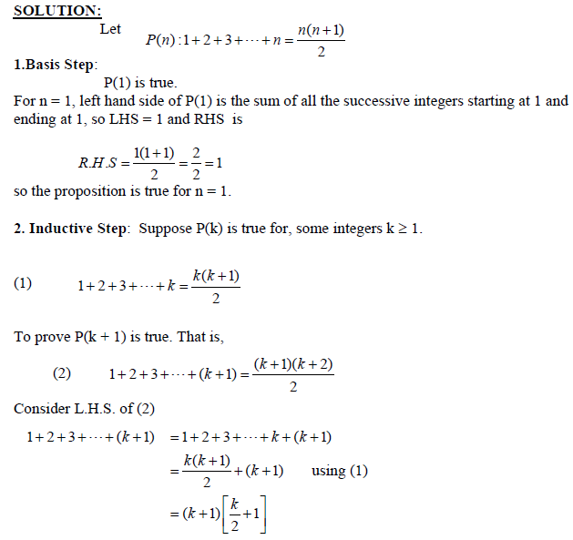

Slide 3
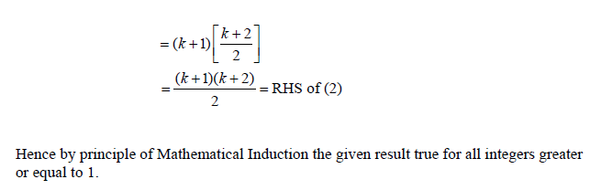

Slide 4
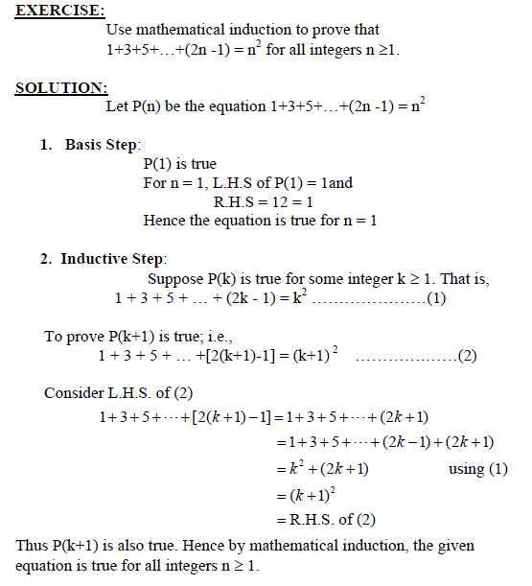

Slide 5
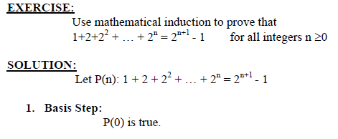
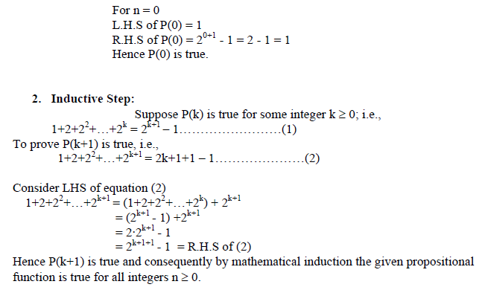

Slide 6
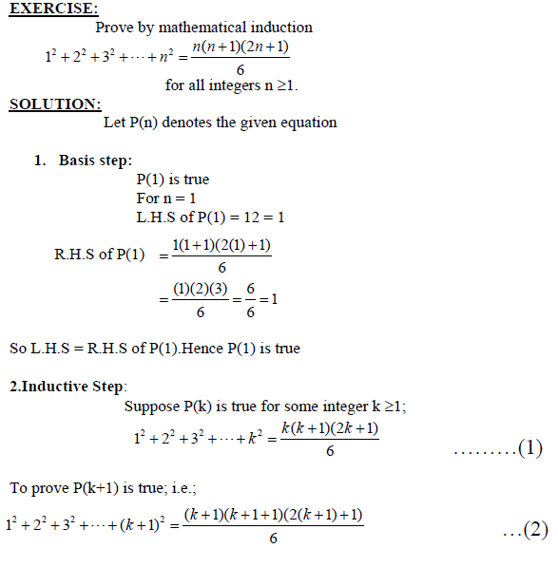

Slide 7
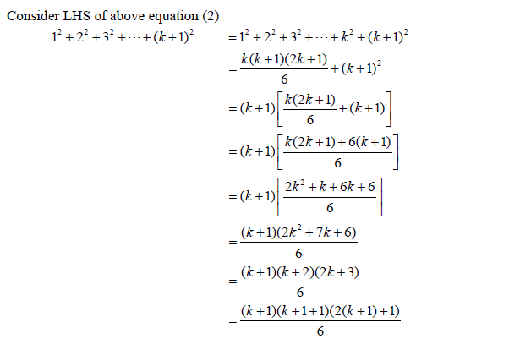

Slide 8
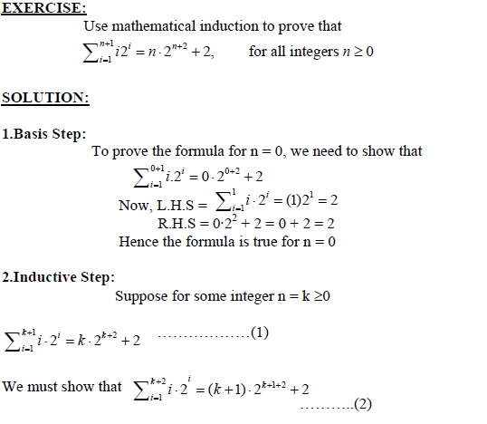

Slide 9
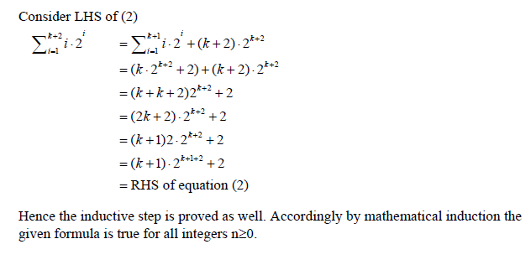

Slide 10
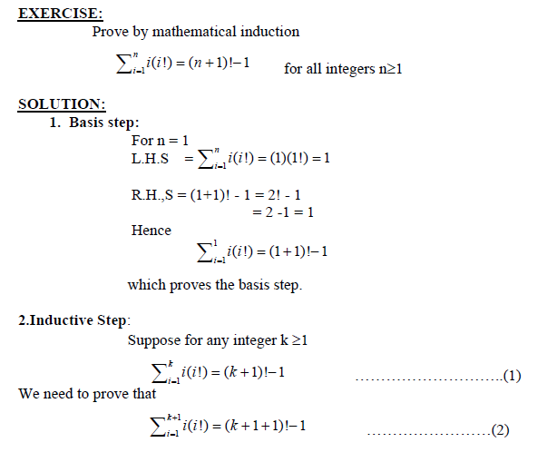

Slide 11
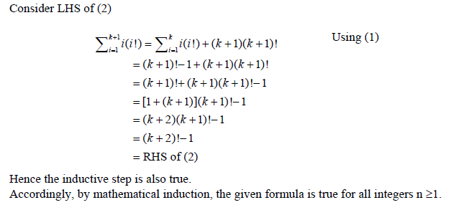

Slide 12
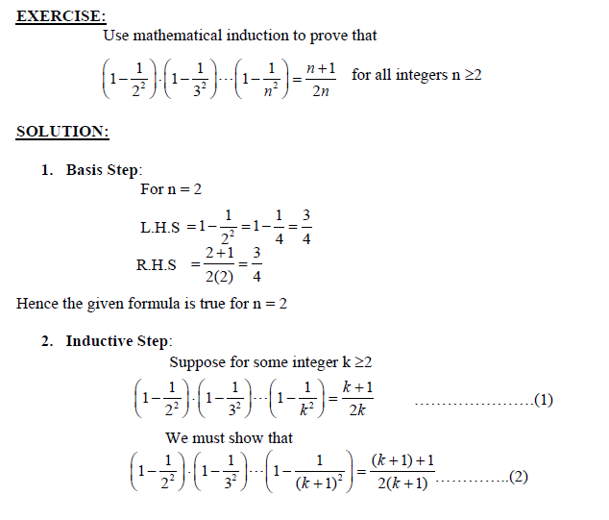

Slide 13
